Slide 1
Java Networking
Asst. Prof. Jignesh Prajapati

Slide 2
Menu
Networking Basics
  TCP, UDP, Ports, DNS, Client-Server Model
TCP/IP in Java
Sockets
URL
  The java classes: URL, URLEncoder, URLConnection, HTTPURLConnection
Datagrams

Slide 3
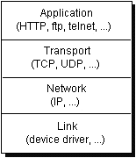
Networking Basics
Computers running on the Internet communicate with each other using either the Transmission Control Protocol (TCP) or the User Datagram Protocol (UDP)

Slide 4
TCP (Transmission Control Protocol)
A connection-based protocol that provides a reliable flow of data between two computers.
Provides a point-to-point channel for applications that require reliable communications.
  The Hypertext Transfer Protocol (HTTP), File Transfer Protocol (FTP), and Telnet are all examples of applications that require a reliable communication channel
Guarantees that data sent from one end of the connection actually gets to the other end and in the same order it was sent. Otherwise, an error is reported.

Slide 5
UDP (User Datagram Protocol)
A protocol that sends independent packets of data, called datagrams, from one computer to another with no guarantees about arrival. UDP is not connection-based like TCP and is not reliable:
  Sender does not wait for acknowledgements
  Arrival order is not guaranteed
  Arrival is not guaranteed
Used when speed is essential, even in cost of reliability
  e.g. streaming media, games, Internet telephony, etc.

Slide 6
Ports
Data transmitted over the Internet is accompanied by addressing information that identifies the computer and the port for which it is destined.
  The computer is identified by its 32-bit IP address, which IP uses to deliver data to the right computer on the network. Ports are identified by a 16-bit number, which TCP and UDP use to deliver the data to the right application.
Why don’t we specify the port in a Web browser?

Slide 7
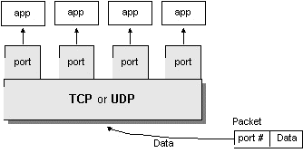
Ports – Cont.
Port numbers range from 0 to 65,535 (16-bit)
  Ports 0 - 1023 are called well-known ports. They are reserved for use by well-known services:
    20, 21: FTP
    23: TELNET
    25: SMTP
    110: POP3
    80: HTTP

Slide 8
Networking Classes in the JDK
Through the classes in java.net, Java programs can use TCP or UDP to communicate over the Internet.
  The URL, URLConnection, Socket, and ServerSocket classes all use TCP to communicate over the network.
  The DatagramPacket, DatagramSocket, and MulticastSocket classes are for use with UDP.

Slide 9
TCP/IP in Java
Accessing TCP/IP from Java is straightforward. The main functionality is in the following classes:
  Java.net.InetAddress : Represents an IP address (either IPv4 or IPv6) and has methods for performing DNS lookup (next slide).
  Java.net.Socket : Represents a TCP socket.
  Java.net.ServerSocket : Represents a server socket which is capable of waiting for requests from clients.

Slide 10
DNS - Domain name system
The Domain Name system (DNS) associates various sorts of information with so-called domain names.
Most importantly, it serves as the "phone book" for the Internet by translating human-readable computer hostnames, e.g. www.example.com, into the IP addresses, e.g. 208.77.188.166, that networking equipment needs to deliver information.
It also stores other information such as the list of mail exchange servers that accept email for a given domain.

Slide 11
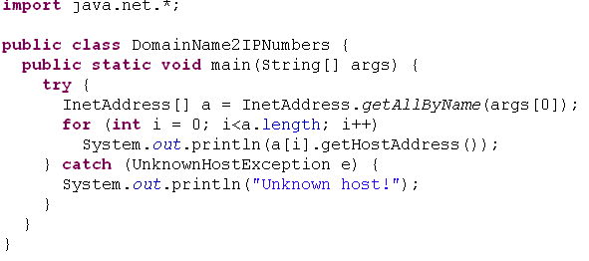
DNS Lookup Example
The following program performs a DNS lookup to find the IP numbers that are associated with a given domain name.

Slide 12
Client-Server Model
A common paradigm for distributed applications
Asymmetry in connection establishment:
  Server waits for client requests at a well known address (IP+port)
  Connection is established upon client request
For example: Web servers and browsers

Slide 13
Sockets: Low-Level Networking
A socket is one endpoint of a two-way communication link between two programs running on the network.
An endpoint is a combination of an IP address and a port number.
A socket is bound to a port number so that the TCP layer can identify the application that data is destined to be sent.

Slide 14
Java Sockets
Java wraps OS sockets (over TCP) by the objects of class java.net.Socket
new Socket(String remoteHost, int remotePort) Creates a TCP socket and connects it to the remote host on the remote port (hand shake)
Write and read using streams:
  InputStream getInputStream()
  OutputStream getOutputStream()
The Socket API

Slide 15
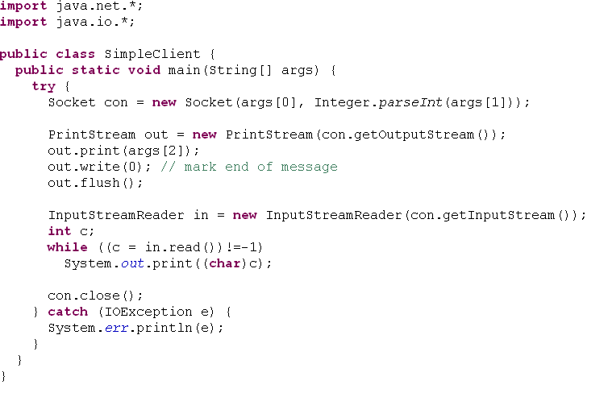
SimpleClient Example
This client tries to connect to a server (coming soon…) and port given on the command line, then sends some output to the server, and finally receives some input which is printed on the screen.
Can you think of a better place for the close action?

Slide 16
Class ServerSocket
This class implements server sockets. A server socket waits for requests to come in over the network. It performs some operation based on that request, and then possibly returns a result to the requester.
A server socket is technically not a socket: when a client connects to a server socket, a TCP connection is made, and a (normal) socket is created for each end point.

Slide 17
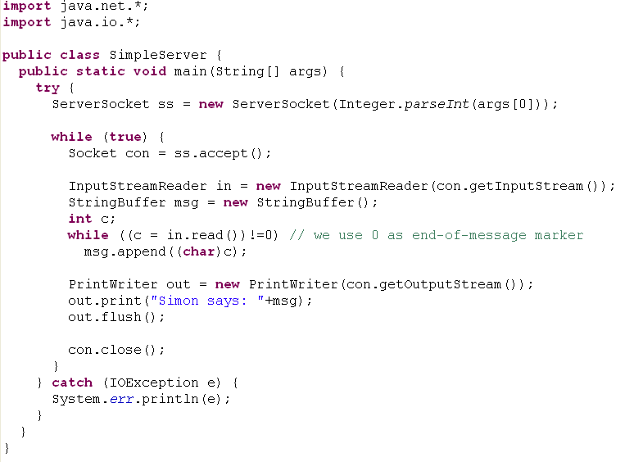
SimpleServer Example
The server creates a server socket that listen on the port given on the command line. It then enters infinite loop doing the following: when a connection with a client is established it reads some input from the client (terminated with a 0 byte), sends back the message ‘Simon says:’ plus the input received, and closes the connection.
Finally would be the right place…

Slide 18
Accepting Connections
Usually, the accept() method is executed within an infinite loop
  i.e., while(true){...}
The accept method returns a new socket (with a new port) for the new channel. It blocks until connection is made
Whenever accept() returns, a new thread is launched to handle that interaction (not in our example)
Hence, the server can handle several requests concurrently

Slide 19
Timeout
You can set timeout values to the blocking accept() method of ServerSocket
Use the method: serverSocket.setSoTimeout(milliseconds)
If timeout is reached before the method returns, java.net.SocketTimeoutException is thrown.

Slide 20
URL - Uniform Resource Locator
URL is a reference (an address) to a resource on the Internet.
  A resource can be a file, a database query and more.
URLs are just a subset of the more general concept of Uniform Resource Identifiers (URIs) which are meant to describe all points in the information space
  http://www.javapassion.com:80/javaintro/index.html#Networking_API
Protocol
Host Name
Port Number
Path & File Name
Reference

Slide 21
Class URL
Class URL represents a Uniform Resource Locator, a pointer to a "resource" on the World Wide Web.
We distinguish between:
  Absolute URL - contains all of the information necessary to reach the resource.
  Relative URL - contains only enough information to reach the resource relative to (or in the context of) another URL.

Slide 22
Class URL Cont.
Constructing URLs:
  URL w3c1 = new URL("http://www.w3.org/TR/");
  URL w3c2 = new URL("http","www.w3.org",80,"TR/");
  URL w3c3 = new URL(w3c2, "xhtml1/");
    If the string is not an absolute URL, then it is considered relative to the URL
    More constructors can be found in the URL API

Slide 23
URL Encoding
URL Encoding is the process of converting string into valid URL format.
Valid URL format means that the URL contains only what is termed "alpha | digit | safe | extra | escape" characters.
  You can read more about the what and the whys of these terms on the World Wide Web Consortium site: http://www.w3.org/Addressing/URL/url-spec.html
  URL Encoding Reference

Slide 24
URL Encoding Cont.
URL encoding is normally performed to convert data passed via html forms, because such data may contain special character, such as "/", ".", "#", and so on, which could either:
  Have special meanings
  Is not a valid character for an URL
For instance, the "#" character needs to be encoded because it has a special meaning of that of an html anchor. The <space> character also needs to be encoded because is not allowed on a valid URL format. Also, some characters, such as "~" might not transport properly across the internet.

Slide 25
URL Encoding Cont.
Example: The URL encoding of “This is a simple & short test” is “This+is+a+simple+%26+short+test “
Note that because the <space> character is very commonly used, a special code ( the "+" sign) has been reserved as its URL encoding

Slide 26
URL addresses with Special characters
Some URL addresses also contain these special characters, for example the space character.
  Like this: http://foo.com/hello world/
To make theses characters legal they need to be encoded before passing them to the URL constructor.
URL url = new URL("http://foo.com/hello%20world");
One class that can help us with this is the URI class :
URI uri = new URI("http", "foo.com", "/hello world/", "");
URL url = uri.toURL();
Another one is the URLEncoder class…

Slide 27
URLEncoder
Contains a utility method encode for converting a string into an encoded format (used in URLs)
To convert a string, each character is examined in turn:
  Space is converted into a plus sign +
  a-z, A-Z, 0-9, ., -, * and _ remain the same.
  The bytes of all special characters are replaced by hexadecimal numbers, preceded with %
To decode an encoded string, use decode() of the class URLDecoder
The URLEncoder API.

Slide 28
MalformedURLException
URL constructors throws a MalformedURLException if the arguments to the constructor refer to a null or unknown protocol. Typically, you want to catch and handle this exception by embedding your URL constructor statements in a try/catch pair, like this:
try
{ URL myURL = new URL(. . .) }
catch(MalformedURLException e)
{ ... // exception handler code here ... }

Slide 29
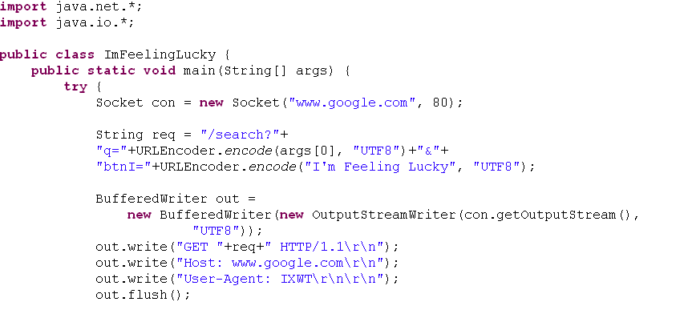
ImFeelingLucky Example
The following program sends a request to the Google server and extracts the result.
Google search engine accepts GET requests of a specific format. It’s reply always contain a Location header line if the search is successful.

Slide 30
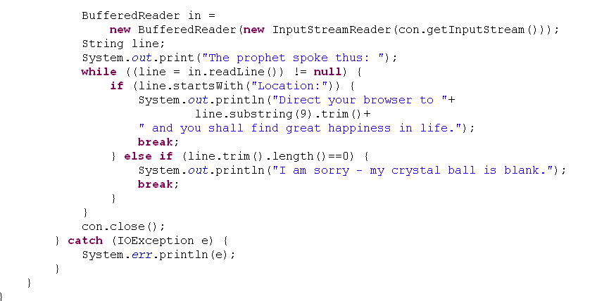
ImFeelingLucky Example Cont.
Finally would be the right place…

Slide 31
Parsing a URL
The following methods of URL can be used for parsing URLs:
getProtocol(), getHost(), getPort(), getPath(), getFile(), getQuery(), getRef()

Slide 32
import java.net.*;
import java.io.*;
public class ParseURL {
public static void main(String[] args) throws Exception {
URL aURL = new URL("http://java.sun.com:80/docs/books/tutorial"
+ "/index.html?name=networking#DOWNLOADING");
System.out.println("protocol = " + aURL.getProtocol());
System.out.println("authority = " + aURL.getAuthority());
System.out.println("host = " + aURL.getHost());
System.out.println("port = " + aURL.getPort());
System.out.println("path = " + aURL.getPath());
System.out.println("query = " + aURL.getQuery());
System.out.println("filename = " + aURL.getFile());
System.out.println("ref = " + aURL.getRef());
}
}
The Output
protocol = http
authority = java.sun.com:80
host = java.sun.com
port = 80
path = /docs/books/tutorial/index.html
query = name=networking
filename = /docs/books/tutorial/index.html?name=networking
ref = DOWNLOADING

Slide 33
URLConnection
Represent a communications link between the application and a URL. Instances of this class can be used both to read from and to write to the resource referenced by the URL.
Creating a connection to a URL:
  The connection object is created by invoking the openConnection method on a URL. If the protocol of the URL is HTTP, the returned object is of class HttpURLConnection.
  The setup parameters and general request properties are manipulated.
  The actual connection to the remote object is made, using the connect method.
  The remote object becomes available. The header fields and the contents of the remote object can be accessed.
See the URLConnection class API for more information

Slide 34
URLConnection Cont.
The life cycle of a URLConnection object has two parts:
  Before actual connection establishment
    Connection configuration (setAllowUserInteraction, setDoInput and more)
  After actual connection establishment
    Content retrieval
Moving from the first phase to the second is implicit
  A result of calling some committing methods, like getDate()

Slide 35
URLConnection Example
import java.net.*;
import java.io.*;
public class URLConnectionReader {
public static void main(String[] args) throws Exception {
URL yahoo = new URL("http://www.yahoo.com/");
URLConnection yc = yahoo.openConnection();
BufferedReader in = new BufferedReader(
new InputStreamReader(
yc.getInputStream()));
String inputLine;
while ((inputLine = in.readLine()) != null)
System.out.println(inputLine);
in.close();
}
}

Slide 36
Class HttpURLConnection
A URLConnection with support for HTTP-specific features.
  responseMessage field
  getRequestMethod()
  usingProxy()
The HttpURLConnection API

Slide 37
Datagrams
A datagram is an independent, self-contained message sent over the network whose arrival, arrival time, and content are not guaranteed.
The java.net package contains three classes to help you write Java programs that use datagrams to send and receive packets over the network: DatagramSocket, DatagramPacket, and MulticastSocket

Slide 38
UDP/IP in Java
Netprog 2002 TCP/IP

Slide 39
UDP Advantages
Less overhead (no connection establishment)
More efficient (no guaranteed delivery)
Real-time applications (no error checking or flow-control)
  E.g., weather, time, video, audio, games
Data reception from more than one machine
Netprog 2002 TCP/IP

Slide 40
Internet Addresses
java.net.InetAddress class
You get an address by using static methods:
  ad = InetAddress.getByName(hostname);
  myAddress = InetAddress.getLocalHost();
Netprog 2002 TCP/IP

Slide 41
Printing Internet Addresses
You get information from an InetAddress by using methods:
  ad.getHostName();
  ad.getHostAddress();
Example.
Netprog 2002 TCP/IP

Slide 42
UDP Sockets Programming
Sending/Receiving data.
  java.net.DatagramPacket class
Creating UDP sockets.
  Client
  Server
  java.net.DatagramSocket class
Netprog 2002 TCP/IP

Slide 43
Creating a UDP packet
// to receive data from a remote machine
DatagramPacket packet =
new DatagramPacket(new byte[256], 256);
// to send data to a remote machine
DatagramPacket packet =
new DatagramPacket( new byte[128], 128,
address, port );
Netprog 2002 TCP/IP

Slide 44
Creating UDP sockets
A UDP socket can be used both for reading and writing packets.
Write operations are asynchronous; however, read operations are blocking.
Since there is no guaranteed delivery, a single-threaded application could stall.
Netprog 2002 TCP/IP

Slide 45
Creating UDP Sockets
// A client datagram socket:
DatagramSocket clientSocket =
new DatagramSocket();
// A server datagram socket:
DatagramSocket serverSocket =
new DatagramSocket(port);
Netprog 2002 TCP/IP

Slide 46
Listening for UDP Packets
// create datagram packet
. . .
// create datagram server socket
. . .
boolean finished = false;
while ( ! finished ) {
serverSocket.receive (packet);
// process the packet
}
serverSocket.close();
Netprog 2002 TCP/IP

Slide 47
Processing UDP Packets
ByteArrayInputStream bin =
new ByteArrayInputStream(
packet.getData() );
DataInputStream din =
new DataInputStream(bin);
// read the contents of the packet
Netprog 2002 TCP/IP

Slide 48
Sending UDP Packets
// create datagram packet
. . .
// create datagram client socket
. . .
boolean finished = false;
while ( ! finished ) {
// write data to packet buffer
clientSocket.send (packet);
// see if there is more to send
}
Netprog 2002 TCP/IP

Slide 49
Sending UDP packets
When you receive a packet, the ip and port number of the sender are set in the DatagramPacket.
You can use the same packet to reply, by overwriting the data, using the method:
  packet.setData(newbuffer);
Netprog 2002 TCP/IP

Slide 50
Non-blocking I/O receiving UDP packets
You can set a time-out in milliseconds to determine how long a read operation blocks, before throwing an exception.
  socket.setSoTimeout(duration);
If the duration given in milliseconds is exceeded, an exception is thrown:
  java.io.InterruptedException
Netprog 2002 TCP/IP

Slide 51
Typical UDP client code
Create UDP socket to contact server (with a given hostname and service port number)
Create UDP packet.
Call send(packet), sending request to the server.
Possibly call receive(packet) (if we need a reply).
Netprog 2002 TCP/IP

Slide 52
Typical UDP Server code
Create UDP socket listening to a well known port number.
Create UDP packet buffer
Call receive(packet) to get a request, noting the address of the client.
Process request and send reply back with send(packet).
Netprog 2002 TCP/IP

Slide 53
Debugging
Debugging UDP can be difficult.
Write routines to print out addresses.
Use a debugger.
Include code that can handle unexpected situations.
Netprog 2002 TCP/IP

Slide 54
Asynchronous Errors
What happens if a client sends data to a server that is not running?
  ICMP “port unreachable” error is generated by receiving host and send to sending host.
  The ICMP error may reach the sending host after send() has already returned!
  The next call dealing with the socket could return the error.
Netprog 2002 TCP/IP

